Slide 1
Backup Enterprise Manager

Slide 2
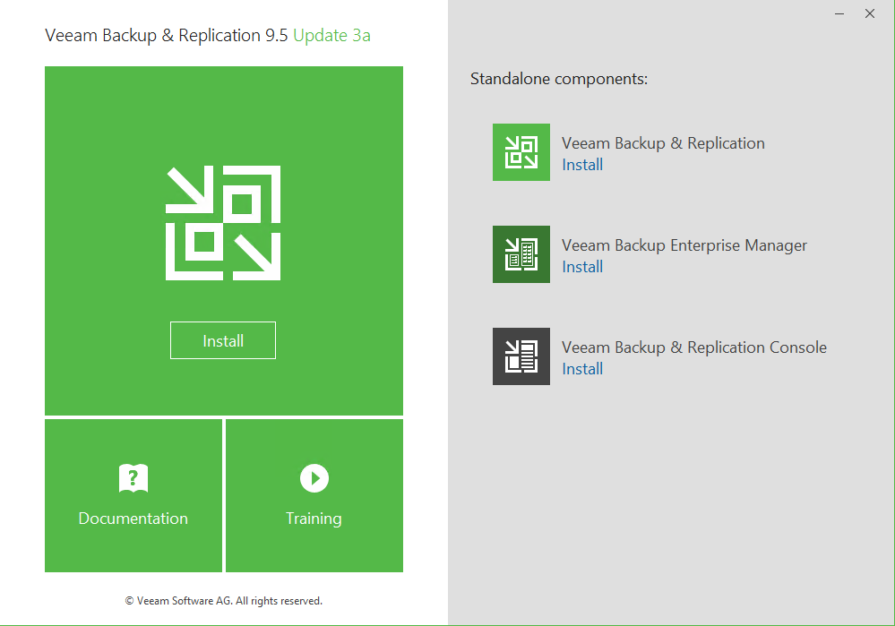
Veeam
Veeam Backup Enterprise Manager
Veeam Backup Enterprise Manager
1. 설치 파일 실행

Slide 3
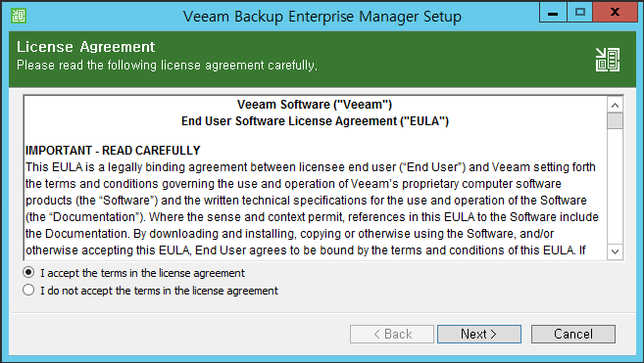
Veeam
Veeam Backup Enterprise Manager
Veeam Backup Enterprise Manager
2. 라이선스 동의

Slide 4
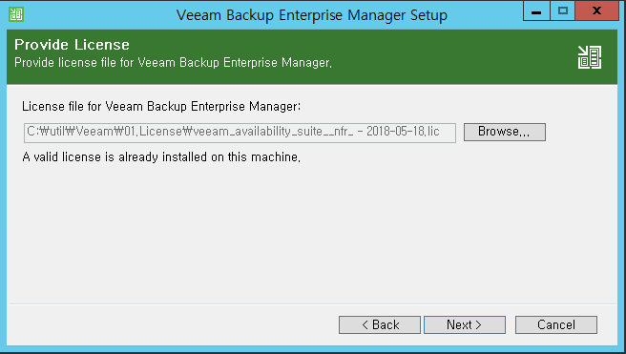
Veeam
Veeam Backup Enterprise Manager
Veeam Backup Enterprise Manager
3. 라이선스 등록

Slide 5
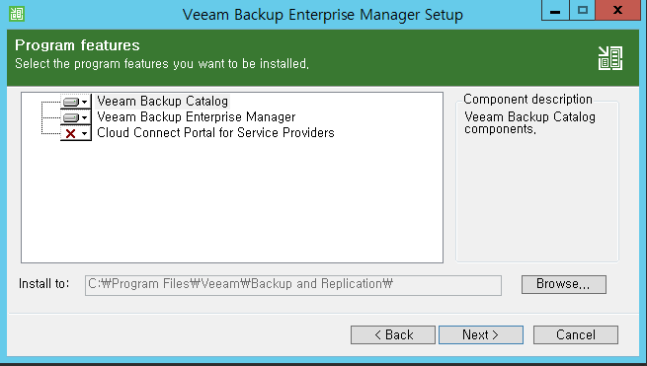
Veeam
Veeam Backup Enterprise Manager
Veeam Backup Enterprise Manager
4. 설치 파일 선택

Slide 6
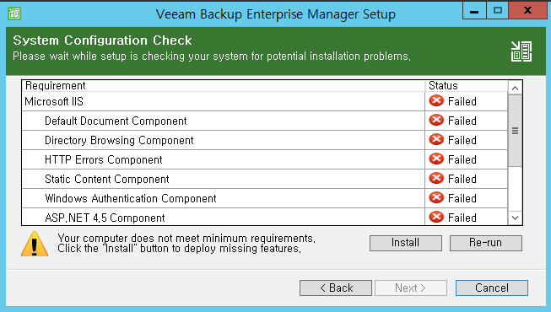
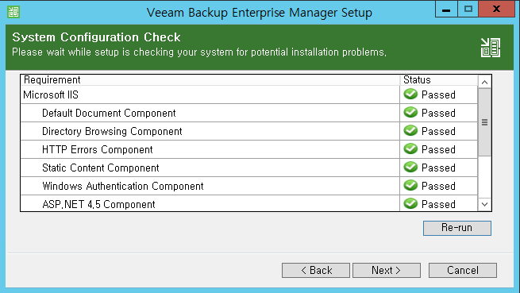
Veeam
Veeam Backup Enterprise Manager
Veeam Backup Enterprise Manager
5. 사전 설치파일 체크 및 설치

Slide 7
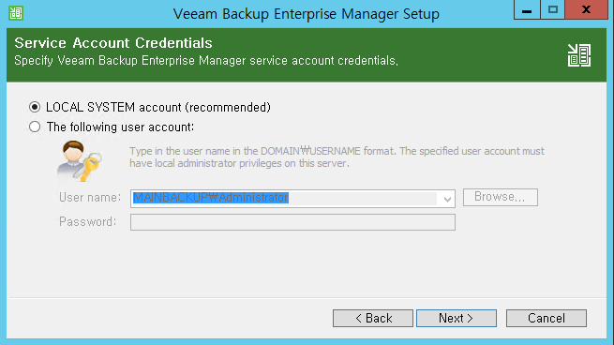
Veeam
Veeam Backup Enterprise Manager
Veeam Backup Enterprise Manager
6. 계정 설정

Slide 8
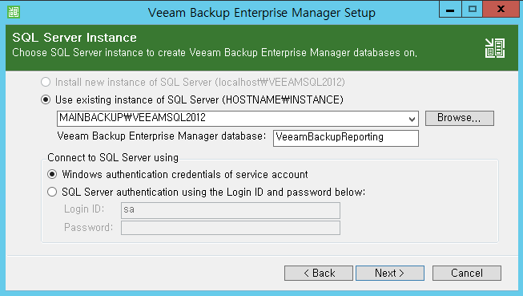
Veeam
Veeam Backup Enterprise Manager
Veeam Backup Enterprise Manager
7. SQL Server Instance

Slide 9
Veeam
Veeam Backup Enterprise Manager
Veeam Backup Enterprise Manager
7. SQL Server Instance

Slide 10
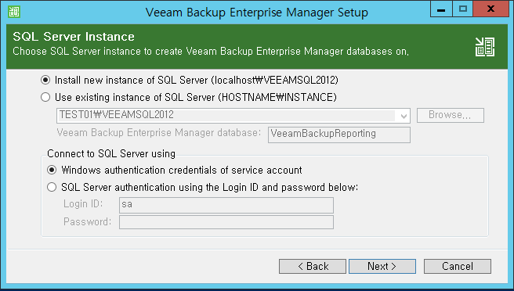
Veeam
Veeam Backup Enterprise Manager
Veeam Backup Enterprise Manager
7. SQL Server Instance

Slide 11
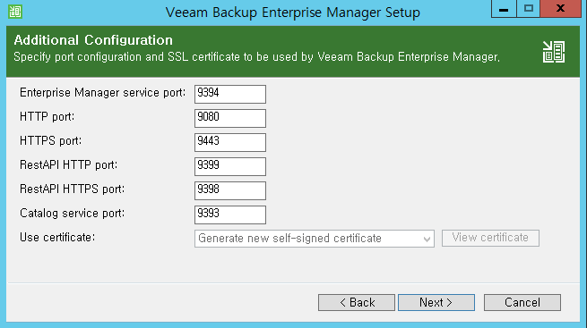
Veeam
Veeam Backup Enterprise Manager
Veeam Backup Enterprise Manager
8. additional Configuration

Slide 12
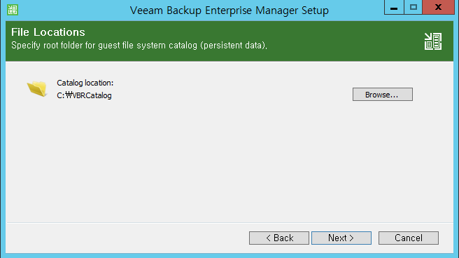
Veeam
Veeam Backup Enterprise Manager
Veeam Backup Enterprise Manager
9. file Locations

Slide 13
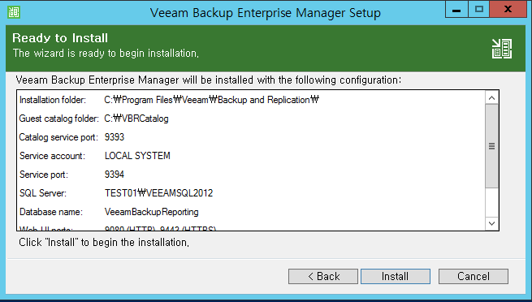
Veeam
Veeam Backup Enterprise Manager
Veeam Backup Enterprise Manager
10. 설정 확인

